Slide 1
Data Preprocessing
  Raw data is often noisy, inconsistent, and incomplete.
  Preprocessing improves data quality and model performance.
  Essential step before data analysis or machine learning.
  Data preprocessing transforms raw data into a clean and usable format for analysis and machine learning models.
  It's a crucial first step that involves cleaning, transforming, integrating, and reducing data to improve quality and efficiency.

Slide 2
Data Preprocessing
Data Preprocessing
│
├── Data Cleaning
│ ├── Missing Values
│ ├── Duplicate Records
│ ├── Inconsistent Data
│ └── Outliers and Noise
│
├── Data Transformation
│ ├── Data Wrangling
│ │ ├── Tidy Data
│ │ ├── Filtering & Sorting
│ │ ├── Joins & Merges
│ │ └── Reshaping
│ │
│ ├── Encoding Categorical Data
│ ├── Normalization / Standardization
│ └── Feature Engineering
│
└── Data Reduction
├── Feature Selection
├── Dimensionality Reduction
└── Numerosity Reduction
  The main steps are
  Data Cleaning: This step focuses on fixing issues within the data to improve its quality. Think of it as tidying up your dataset.
  Data Transformation: This step involves modifying the data's structure or format to make it more suitable for machine learning algorithms.
  Data Reduction: This step aims to reduce the size of the dataset without sacrificing important information, making the analysis faster and more efficient.

Slide 3
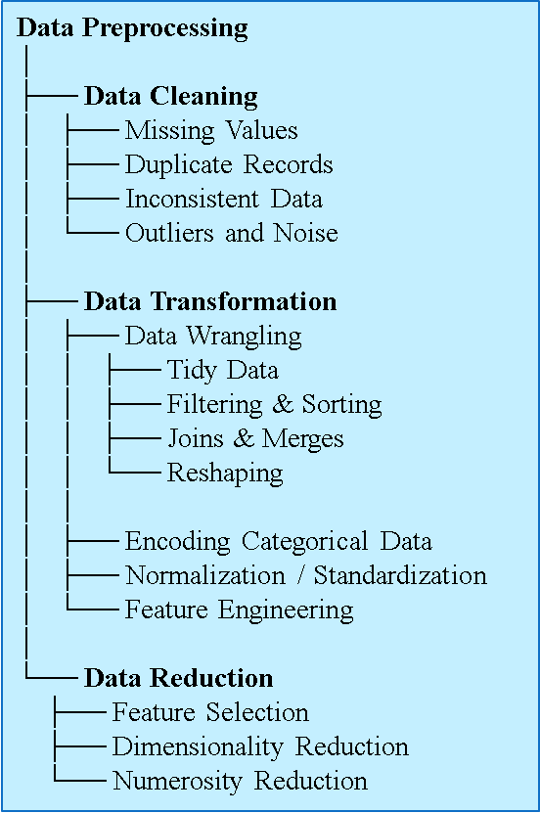
Data Preprocessing : Data Cleaning
  Handling Missing Values
  Handling missing values is a crucial data cleaning step because most machine learning algorithms cannot work with empty or null data points.
  Choosing the right method depends on the nature of the data and the amount of missing information.
  Let's use a simple example dataset to discuss the common techniques.

Slide 4
Data Preprocessing : Data Cleaning
  Handling Missing Values
  Example Dataset: Employee Info
  Imagine we have the following data about employees. The NaN values represent missing data.
Employee ID | Age | Experience (Years) | Salary
101 | 25 | 2 | 50,000
102 | 30 | NaN | 65,000
103 | 45 | 20 | 120,000
104 | 28 | 5 | NaN
105 | 50 | 25 | 140,000

Slide 5
Data Preprocessing : Data Cleaning
  Handling Missing Values
  1. Deletion Methods
  The simplest approach is to just remove the missing data.
  Listwise Deletion: This involves deleting the entire row that contains a missing value. In our example, we would remove the rows for Employee ID 102 and 104.
Employee ID | Age | Experience (Years) | Salary
101 | 25 | 2 | 50,000
102 | 30 | NaN | 65,000
103 | 45 | 20 | 120,000
104 | 28 | 5 | NaN
105 | 50 | 25 | 140,000
Employee ID | Age | Experience (Years) | Salary
101 | 25 | 2 | 50,000
103 | 45 | 20 | 120,000
105 | 50 | 25 | 140,000

Slide 6
Data Preprocessing : Data Cleaning
  Handling Missing Values
  1. Deletion Methods
  Pros: Easy and fast.
  Cons:
  You lose a lot of data, which can lead to a biased model if the missing values aren't random.
  This is only recommended if you have a very large dataset and only a few rows with missing values.
Employee ID | Age | Experience (Years) | Salary
101 | 25 | 2 | 50,000
102 | 30 | NaN | 65,000
103 | 45 | 20 | 120,000
104 | 28 | 5 | NaN
105 | 50 | 25 | 140,000
Employee ID | Age | Experience (Years) | Salary
101 | 25 | 2 | 50,000
103 | 45 | 20 | 120,000
105 | 50 | 25 | 140,000

Slide 7
Data Preprocessing : Data Cleaning
  Handling Missing Values
  2. Imputation with a Single Value
  Imputation means filling in the missing values. The most common way is to use a statistical measure from the column.
  Mean/Median Imputation: You can replace missing numerical data with the mean (average) or median (middle value) of the column. The median is often preferred because it's less sensitive to outliers.
  Mode Imputation: For categorical data (e.g., a 'Department' column), you'd use the mode (the most frequent value).
  Let's apply this to our original dataset.

Slide 8
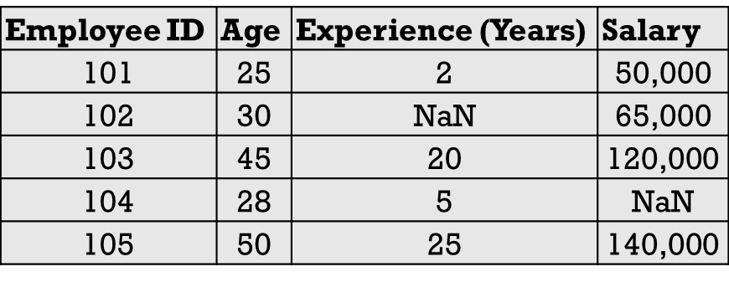
Data Preprocessing : Data Cleaning
  Handling Missing Values
  2. Imputation with a Single Value
  Step 1: Calculate the mean for 'Experience' and 'Salary'.
  Known 'Experience' values: 2, 20, 5, 25.
  Mean Experience = (2+20+5+25)/4=13 years.
  Known 'Salary' values: 50000, 65000, 120000, 140000.
  Mean Salary = 50000+65000+120000+140000)/4=93,750.

Slide 9
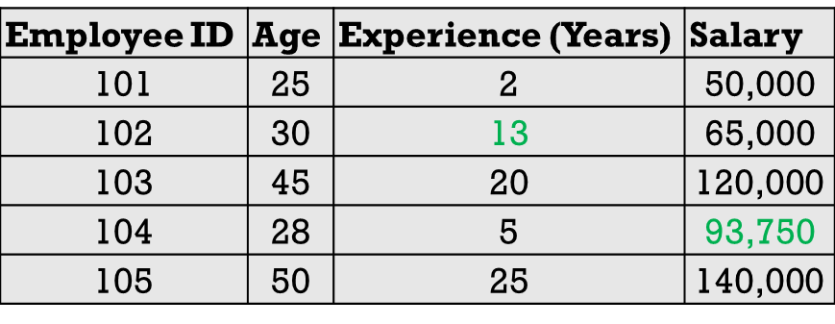
Data Preprocessing : Data Cleaning
  Handling Missing Values
  2. Imputation with a Single Value
  Step 2: Fill in the NaN values.
  The missing 'Experience' for employee 102 becomes 13.
  The missing 'Salary' for employee 104 becomes 93,750.
  Pros:
  Simple to implement and retains all data rows.
  Cons:
  Can reduce the natural variance in the data and weaken the relationships between variables, as it doesn't account for correlations.
  For instance, a 28-year-old is now assigned the average salary, which might not be realistic.

Slide 10
Data Preprocessing : Data Cleaning
  Handling Missing Values
  3. Advanced Imputation Method
  More sophisticated techniques use other features to predict the missing values.
  Regression Imputation: This method builds a regression model to predict the missing value. For example, we could create a model to predict 'Salary' based on 'Age' and 'Experience'. We would train this model on the complete rows (101, 103, 105) and then use it to predict the salary for employee 104.
  K-Nearest Neighbors (KNN) Imputation: This method finds the 'k' most similar data points (neighbors) to the one with the missing value and then imputes the missing value based on the average of its neighbors.
  Pros: Usually more accurate than simple imputation and better at preserving relationships between variables.
  Cons: Much more complex to implement and computationally expensive.

Slide 11
Data Preprocessing : Data Cleaning
  Handling Duplicate Records
  Duplicate records occur when the same observation appears more than once in a dataset.
Why Are Duplicate Records a Problem?
Duplicate records can:
Inflate dataset size
Produce incorrect statistics
Bias machine learning models
Lead to incorrect business decisions
StudentID | Name | CGPA
101 | Rahim | 3.75
102 | Karim | 3.40
102 | Karim | 3.40
103 | Nabila | 3.90
StudentID | Name | CGPA
101 | Rahim | 3.75
102 | Karim | 3.40
103 | Nabila | 3.90

Slide 12
Data Preprocessing : Data Cleaning
  Correcting Inaccurate or Inconsistent Data
  Correcting inaccurate or inconsistent data is the process of identifying and fixing errors, contradictions, and structural issues to ensure your dataset is reliable and uniform.
  Think of it as proofreading your data to make sure every entry is accurate and follows the same set of rules.
  This process is vital because inconsistencies can lead to incorrect analysis, biased models, and flawed conclusions.
  Next is how to do it, broken down by common types of errors.

Slide 13
Data Preprocessing : Data Cleaning
  Correcting Inaccurate or Inconsistent Data
  1. Correcting Inconsistent Categorical Data
  This happens when the same category is represented in multiple ways.
  The Problem: A 'Country' column might contain "USA," "U.S.A.," "United States," and "America." A data analysis tool would treat these as four different countries.
  How to Fix It (Standardization):
  Explore Unique Values: First, identify all the unique entries in the column
  Define a Standard: Decide on a single, standard representation.
  Create a Mapping: Create a dictionary to map the variations to your chosen standard. Use the map to replace the inconsistent values.

Slide 14
Data Preprocessing : Data Cleaning
  Correcting Inaccurate or Inconsistent Data
  2. Fixing Structural Errors
  These are typos, unwanted characters, or inconsistent capitalization that affect data quality.
  The Problem: A 'Name' column might have entries like " John Smith ", "john smith", or "John_Smith".
  How to Fix It (Cleaning and Formatting):
  Trim Whitespace: Remove any leading or trailing spaces. Most programming languages have a trim() or strip() function.
  Standardize Case: Convert all text to a single case (usually lowercase) to ensure consistency. Use a lower() function.
  Remove Unwanted Characters: Use a replace() function to remove special characters like underscores or dashes if they don't belong.

Slide 15
Data Preprocessing : Data Cleaning
  Correcting Inaccurate or Inconsistent Data
  3. Resolving Logical Errors and Contradictions
  This involves finding data points that are logically impossible or contradict other information in the dataset.
  The Problem:
  A person's Date of Death is earlier than their Date of Birth.
  An 'Age' column shows 15, but the 'Employment Status' column says Full-Time Employee.
  An Order_Date is later than the Shipping_Date.

Slide 16
Data Preprocessing : Data Cleaning
  Correcting Inaccurate or Inconsistent Data
  3. Resolving Logical Errors and Contradictions
  How to Fix It (Validation Rules):
  Define Rules: Establish logical rules that your data must follow (e.g., Age must be greater than 18 for Employment Status == 'Full-Time Employee').
  Flag Violations: Write a script to check each row against your rules and flag the ones that fail.
  Correct Manually or Programmatically: For some errors, you might need to investigate the original source to find the correct data. For others, you might set the problematic entry to NaN (missing) and handle it later. If a Date of Birth is "1992" and Age is "20", you could write a rule to recalculate the age based on the current date.

Slide 17
Data Preprocessing : Data Cleaning
  Correcting Inaccurate or Inconsistent Data
  4. Standardizing Units and Formats
  This ensures all numerical data and dates are comparable.
  The Problem:
  A 'Weight' column contains values in both pounds (lbs) and kilograms (kg).
  A 'Date' column has multiple formats like "07-25-2025," "25/Jul/2025.
  How to Fix It (Conversion and Parsing):
  For Numerical Units: Identify the different units present. Choose a standard unit (e.g., kg) and apply a conversion formula to all non-standard entries (e.g., weight_in_kg = weight_in_lbs * 0.453592).
  For Dates: Use a robust date-parsing function to automatically recognize and convert all date formats into a single, standard format, like YYYY-MM-DD.

Slide 18
Data Preprocessing : Data Cleaning
  Handling Outliers and Noise
  Handling outliers and noise is a critical data cleaning step to prevent skewed results and improve model accuracy. While related, they are different:
  Outliers are legitimate data points that are unusually far from the rest of the data. Think of the net worth of a billionaire in a sample of regular citizens.
  Noise is random error or variance in the data, like a slight fluctuation in a sensor reading.

Slide 19
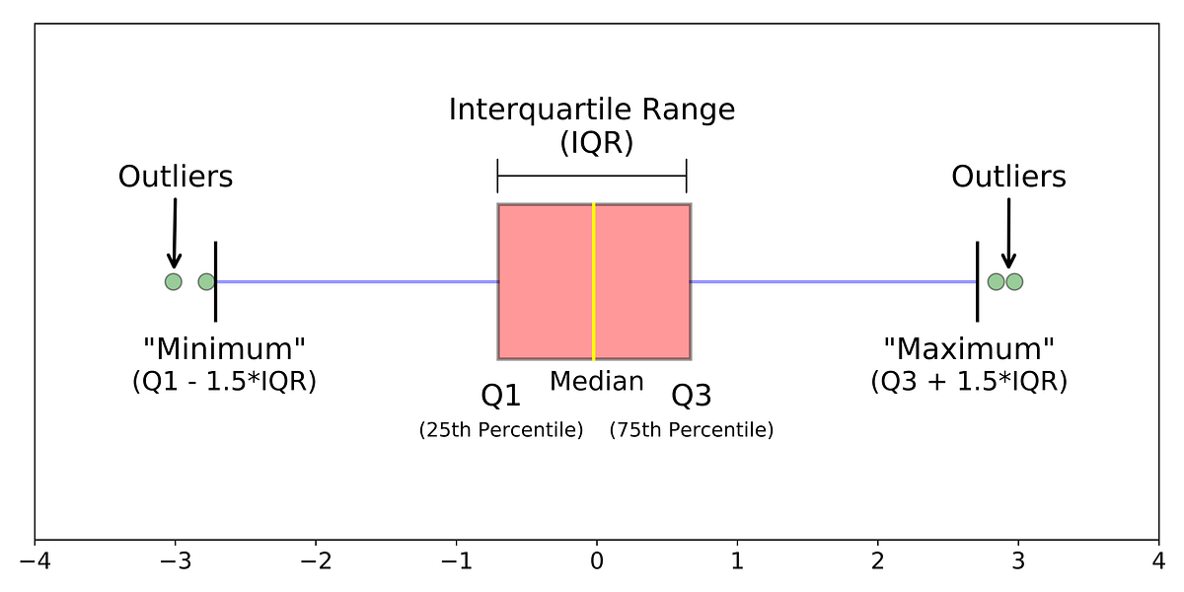
Data Preprocessing : Data Cleaning
  Outliers Detection
  The first step is to find the outliers, and then you can decide what to do with them.
  Visual Method (Box Plots):
  This is the easiest way to "see" outliers. A box plot visualizes the distribution of data. Any data point that falls outside the "whiskers" of the plot is typically considered an outlier.

Slide 20
Data Preprocessing : Data Cleaning
  Outliers Detection
  Statistical Method (Interquartile Range - IQR):
  The IQR method provides a numerical way to identify outliers.
    Calculate the first quartile (Q1, the 25th percentile) and the third quartile (Q3, the 75th percentile).
    Calculate the IQR: IQR=Q3−Q1.
    Define the outlier boundaries. A data point is considered an outlier if it falls below Q1−1.5 times IQR or above Q3+1.5 times IQR.
  Z-Score Method:
  The Z-score tells you how many standard deviations a data point is from the mean. A common rule of thumb is that any point with a Z-score greater than 3 or less than -3 is an outlier.

Slide 21
Data Preprocessing : Data Cleaning
  Outliers Handling
Method | Description | When to use
Remove | Delete outlier rows | Small number; known data entry errors
Cap / Winsorize | Replace outliers with nearest boundary value | Preserve sample size; mild outliers
Transform | Log, Box-Cox, etc. | Reduce skewness; keep all data
Treat separately | Keep as a separate category | Meaningful outliers (e.g., fraud, extreme events)

Slide 22
Data Preprocessing : Data Cleaning
  Handling Noise
  Handling noise involves using "smoothing" techniques to remove random fluctuations and reveal the underlying trend.
  1. Binning:
  This method groups a range of continuous values into "bins" or intervals. After creating the bins, you can smooth the data by replacing every value in a bin with the bin's mean, median, or boundary value.
  Example: Imagine the sorted price data: [3, 5, 8, 15, 16, 17, 25, 26, 30].
  You could create 3 bins: [3, 5, 8], [15, 16, 17], and [25, 26, 30].
  If you smooth by the mean, the data becomes [5.3, 5.3, 5.3], [16, 16, 16], and [27, 27, 27].

Slide 23
Data Preprocessing : Data Cleaning
  Handling Noise
  2. Regression:
  You can fit a regression line (or curve) to the data. The data points on this line are considered the "smoothed," noise-free values. The original data points are then replaced with their corresponding values on the regression line.
  3. Moving Averages:
  This is very common for time-series data (like stock prices or temperature readings). It smooths the data by calculating the average of a "sliding window" of a fixed size. For example, a 7-day moving average would replace each day's value with the average of that day, the 3 previous days, and the 3 following days. This smooths out daily fluctuations and highlights the longer-term trend.

Slide 24
Data Preprocessing : Data Transformation
  Data Wrangling
  Data Wrangling (also called Data Munging) is the process of transforming raw data into a clean, structured, and analysis-ready format.
  Goal
  Organize data
  Restructure data
  Combine data from multiple sources
  Prepare data for analysis and machine learning

Slide 25
Data Preprocessing : Data Transformation
  Tidy Data
  Tidy Data is a standardized way of organizing data where:
  Each variable forms a column
  Each observation forms a row
  Each value occupies a single cell
  These principles were popularized by Hadley Wickham.
  Most data analysis and visualization tools work best when data follows a consistent structure.
  Benefits:
  Easier analysis
  Easier visualization
  Easier data manipulation

Slide 26
Data Preprocessing : Data Transformation
  Common Data Wrangling Tasks:
  Filtering: Select rows that satisfy specific conditions.
  Filter: CGPA > 3.5
Student | CGPA
Rahim | 3.8
Karim | 3.2
Nabila | 3.9
Student | CGPA
Rahim | 3.8
Nabila | 3.9

Slide 27
Data Preprocessing : Data Transformation
  Common Data Wrangling Tasks
  Sorting: Arrange data in ascending or descending order.
  After sorting (descending):
Student | CGPA
Rahim | 3.8
Karim | 3.2
Nabila | 3.9
Student | CGPA
Nabila | 3.9
Rahim | 3.8
Karim | 3.2

Slide 28
Data Preprocessing : Data Transformation
  Common Data Wrangling Tasks:
  Joins and Merges: Combine information from multiple datasets.
  After Merge
ID | Name
1 | Rahim
2 | Karim
ID | CGPA
1 | 3.8
2 | 3.5
ID | Name | CGPA
1 | Rahim | 3.8
2 | Karim | 3.5

Slide 29
Data Preprocessing : Data Transformation
  Common Data Wrangling Tasks:
  Reshaping Data: Change the structure of a dataset.
Student | Quiz1 | Quiz2
Rahim | 80 | 85
Karim | 75 | 88
Student | Quiz | Marks
Rahim | Quiz1 | 80
Rahim | Quiz2 | 85
Karim | Quiz1 | 75
Karim | Quiz2 | 88

Slide 30
Data Preprocessing : Data Transformation
  Encoding Categorical Data
  Encoding categorical data is the process of converting text-based categories into numbers so that machine learning algorithms can process them.
  Let's use a simple example. Imagine you have survey data with a "Favorite Fruit" column.
  A machine learning model can't understand "Apple" or "Orange." We need to encode these labels into numbers. Here are the two most common ways to do that.
Person ID | Favorite Fruit
1 | Apple
2 | Orange
3 | Banana
4 | Apple
5 | Banana

Slide 31
Data Preprocessing : Data Transformation
Person ID | Favorite Fruit
1 | Apple
2 | Orange
3 | Banana
4 | Apple
5 | Banana
  1. Label Encoding
  Important Note:
  Be careful using this for non-ordered (nominal) data.
  Label Encoding creates an artificial order (Banana (2) > Orange (1)), which can mislead some models into thinking there's a ranking when there isn't one.
Person ID | Favorite Fruit | Favorite Fruit (Encoded)
1 | Apple | 0
2 | Orange | 1
3 | Banana | 2
4 | Apple | 0
5 | Banana | 2

Slide 32
Data Preprocessing : Data Transformation
  2. One-Hot Encoding
  This is the preferred method for nominal data (categories without a natural order). It creates a new binary (0 or 1) column for each unique category.
Person ID | Favorite Fruit
1 | Apple
2 | Orange
3 | Banana
4 | Apple
5 | Banana
  How it works:
  Identify all unique categories: "Apple," "Orange," "Banana.“
  Create a new column for each category.
  For each row, place a 1 in the column corresponding to its category and 0s in all other new columns.
Person ID | Favorite Fruit | Apple | Orange | Banana
1 | Apple | 1 | 0 | 0
2 | Orange | 0 | 1 | 0
3 | Banana | 0 | 0 | 1
4 | Apple | 1 | 0 | 0
5 | Banana | 0 | 0 | 1

Slide 33
Data Preprocessing : Data Transformation
  2. One-Hot Encoding
  This method effectively represents the categories without creating any false relationships between them, making it a safer and often more effective choice for most machine learning tasks.
Person ID | Favorite Fruit
1 | Apple
2 | Orange
3 | Banana
4 | Apple
5 | Banana
Person ID | Favorite Fruit | Apple | Orange | Banana
1 | Apple | 1 | 0 | 0
2 | Orange | 0 | 1 | 0
3 | Banana | 0 | 0 | 1
4 | Apple | 1 | 0 | 0
5 | Banana | 0 | 0 | 1

Slide 34
Data Preprocessing : Data Transformation
  Normalization and Standardization
  Normalization and Standardization are two essential data transformation techniques used to scale numerical features to a common level, but they do so in different ways.
  Let's use a simple dataset to illustrate both. Imagine we have data for a small group of people and we want to scale the 'Income' feature.
Person | Age | Income
A | 25 | 50,000
B | 30 | 65,000
C | 45 | 120,000
D | 50 | 140,000
E | 35 | 95,000

Slide 35
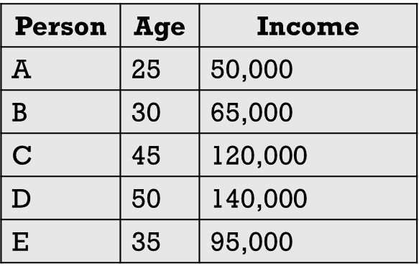
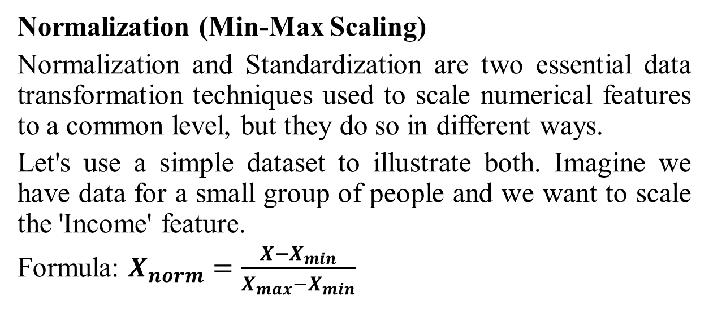
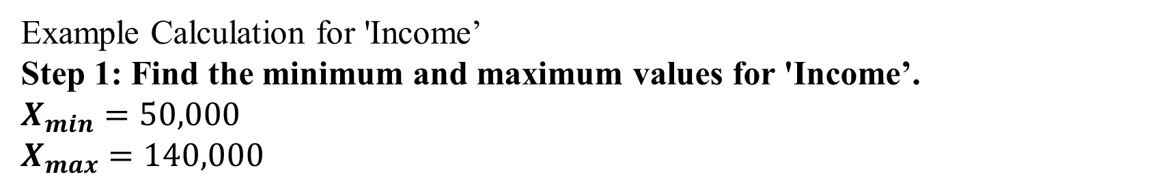
Data Preprocessing : Data Transformation
  Normalization (Min-Max Scaling)
  Normalization and Standardization are two essential data transformation techniques used to scale numerical features to a common level, but they do so in different ways.
  Let's use a simple dataset to illustrate both. Imagine we have data for a small group of people and we want to scale the 'Income' feature.
  Formula: $X_{norm}=\frac{X−X_{min}}{X_{max}−X_{min}}$
Example Calculation for 'Income’
Step 1: Find the minimum and maximum values for 'Income’.
$X_{min}=50,000$​
$$X_{max}=140,000$$

Slide 36
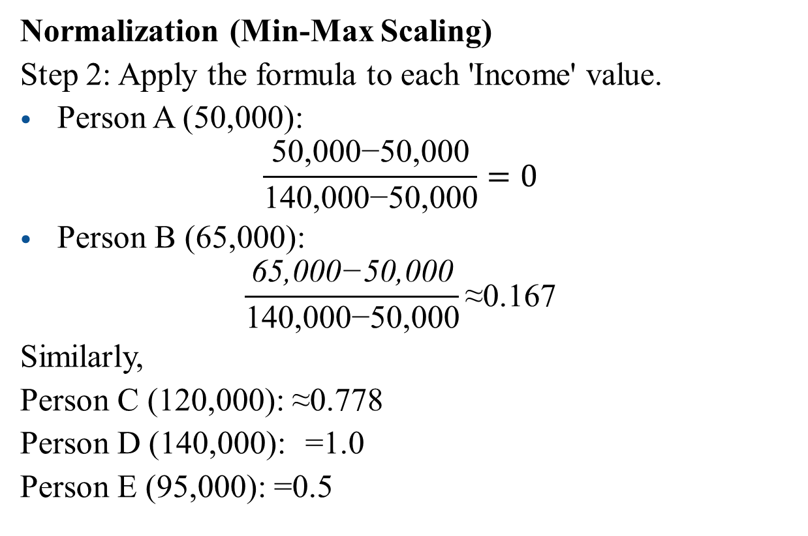
Data Preprocessing : Data Transformation
  Normalization (Min-Max Scaling)
  Step 2: Apply the formula to each 'Income' value.
  Person A (50,000):
  $$\frac{\text{50,000−50,000}}{\text{140,000−50,000}}=0$$
  Person B (65,000):
  $$\frac{\text{65,000−50,000}}{\text{140,000−50,000}}\text{≈0.167}$$
  Similarly,
  Person C (120,000): ≈0.778
  Person D (140,000): =1.0
  Person E (95,000): =0.5
Person | Age | Income
A | 25 | 0
B | 30 | 0.167
C | 45 | 0.778
D | 50 | 1.0
E | 35 | 0.5

Slide 37
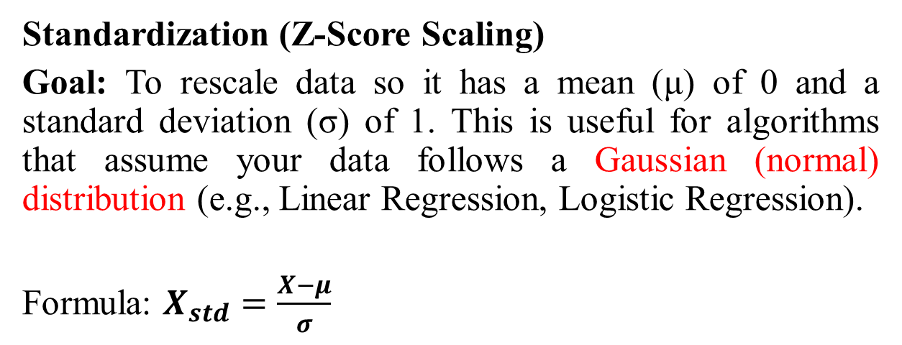
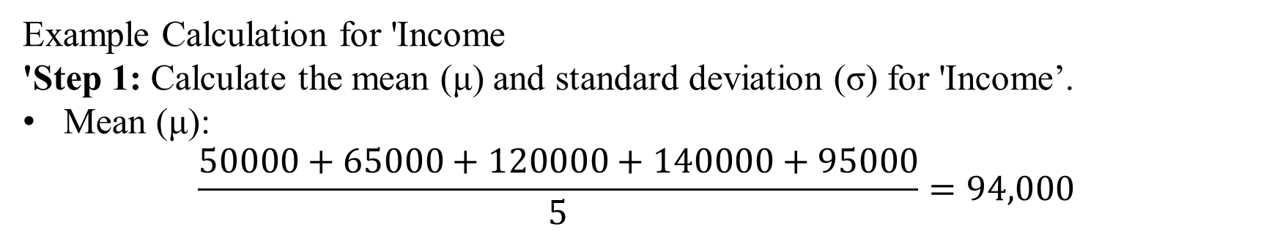
Data Preprocessing : Data Transformation
  Standardization (Z-Score Scaling)
  Goal: To rescale data so it has a mean (μ) of 0 and a standard deviation (σ) of 1. This is useful for algorithms that assume your data follows a Gaussian (normal) distribution (e.g., Linear Regression, Logistic Regression).
  Formula: $X_{std}=\frac{X−μ}{σ}$
Example Calculation for 'Income
'Step 1: Calculate the mean (μ) and standard deviation (σ) for 'Income’.
Mean (μ):
$$\frac{50000+65000+120000+140000+95000​}{5}=94,000$$

Slide 38
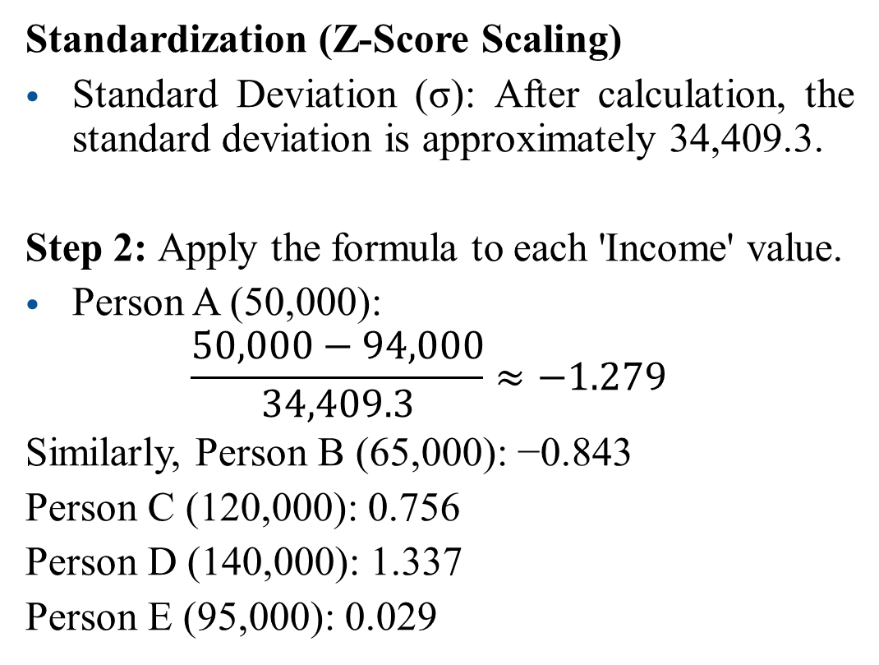
Data Preprocessing : Data Transformation
  Standardization (Z-Score Scaling)
  Standard Deviation (σ): After calculation, the standard deviation is approximately 34,409.3.
  Step 2: Apply the formula to each 'Income' value.
  Person A (50,000):
  $$\frac{50,000−94,000}{34,409.3}≈−1.279$$
  Similarly, Person B (65,000): −0.843
  Person C (120,000): 0.756
  Person D (140,000): 1.337
  Person E (95,000): 0.029
Person | Original Income | Normalized Income | Standardized Income
A | 50,000 | 0.000 | -1.279
B | 65,000 | 0.167 | -0.843
C | 120,000 | 0.778 | 0.756
D | 140,000 | 1.000 | 1.337
E | 95,000 | 0.500 | 0.029

Slide 39
Data Preprocessing : Data Transformation
  Feature Engineering
  The process of creating new, informative features (variables) from existing data to improve analysis and machine learning performance.
  Why Do We Need Feature Engineering?
  Raw data is often not the most useful form for analysis.
  Can I create a new variable that captures more useful information than the original variables?

Slide 40
Data Preprocessing : Data Transformation
  Common Feature Engineering Tasks
  1. Creating New Features
Student | Midterm | Final
Rahim | 70 | 80
Karim | 65 | 75
The new feature Total may be more informative
Student | Midterm | Final | Total
Rahim | 70 | 80 | 150
Karim | 65 | 75 | 140

Slide 41
Data Preprocessing : Data Transformation
  Common Feature Engineering Tasks
  2. Deriving Features from Dates
Date
2025-06-10
2025-12-25
Year | Month | Day
2025 | 6 | 10
2025 | 12 | 25

Slide 42
Data Preprocessing : Data Transformation
  Common Feature Engineering Tasks
  3. Creating Age from Birth Year
Birth Year
2003
2001
Birth Year | Age
2003 | 22
2001 | 24

Slide 43
Data Preprocessing : Data Transformation
  Common Feature Engineering Tasks
  4. Creating Categories (Binning)
Age
18
22
35
60
Age | Age Group
18 | Young
22 | Young
35 | Adult
60 | Senior

Slide 44
Data Preprocessing : Data Transformation
  Common Feature Engineering Tasks
  5. Creating Ratios
Income | Expenses
50000 | 30000
70000 | 35000
Income | Expenses | Savings Rate
50000 | 30000 | 0.40
70000 | 35000 | 0.50

Slide 45
Data Preprocessing : Data Transformation
  Feature Engineering: Another Example
Original Features | Engineered Features
area_sqft | price_per_sqft
num_bedrooms | bedrooms_squared
build_year | age_group, house_age
location | proximity_to_center, has_good_school

Slide 46
Data Preprocessing : Data Reduction
  Feature Selection
  Feature Selection is the process of selecting the most relevant features (variables) from a dataset and removing unnecessary ones.
  Goal
  Reduce dataset complexity
  Improve model performance
  Reduce training time
  Improve interpretability

Slide 47
Data Preprocessing : Data Reduction
  Feature Selection
  Suppose we want to predict student performance.
  Do we need all variables?
  Maybe:
  Study Hours, Attendance are more useful than:
  Height, Weight for predicting CGPA.
  Feature Selection helps us identify and keep the important variables.
Age | Height | Weight | Study Hours | Attendance | CGPA
20 | 170 | 65 | 15 | 85 | 3.5

Slide 48
Data Preprocessing : Data Reduction
  Feature Selection vs. Feature Engineering
  How Do We Select Features?
Method 1: Domain Knowledge
Example: To predict CGPA:
✔ Study Hours ✔ Attendance ✖ Favorite Color
Feature Engineering | Feature Selection
Creates new features | Chooses existing features
Adds variables | Removes variables
Example: Total = Midterm + Final | Remove Height and Weight

Slide 49
Data Preprocessing : Data Reduction
  How Do We Select Features?
Method 2: Correlation Analysis
Compute correlation with the target variable.
Conclusion: Height may be removed.
Feature | Correlation with CGPA
Study Hours | 0.82
Attendance | 0.74
Height | 0.05

Slide 50
Data Preprocessing : Data Reduction
  How Do We Select Features?
Method 3: Variance Threshold
Remove features with almost no variation.
This variable contains little information.
Student | Country
1 | Bangladesh
2 | Bangladesh
3 | Bangladesh

Slide 51
Data Preprocessing : Data Reduction
  Dimensionality Reduction: This reduces the number of features (columns). High-dimensional data can lead to poor model performance (the "curse of dimensionality"). Techniques like Principal Component Analysis (PCA) create a smaller set of new features that capture most of the original data's variance.

Slide 52
Data Preprocessing : Data Reduction
  Details of PCA will be taught later

Slide 53
Data Preprocessing : Data Reduction
  Numerosity Reduction: This reduces the number of data entries (rows). When dealing with massive datasets, you can use sampling (selecting a representative subset of the data) or use models like clustering or regression to represent the data more compactly.
Goal
Reduce storage requirements
Speed up analysis
Reduce computational cost
Preserve key information

Slide 54
Data Preprocessing : Data Reduction
  Types of Numerosity Reduction
  1. Sampling
  Suppose a company has:10,000,000 customer records. Do we always need to analyze all 10 million records?
  Sometimes we can use a smaller representation and obtain similar insights.
100,000 Records
↓
Random Sampling
↓
5,000 Records

Slide 55
Data Preprocessing : Data Reduction
  Types of Numerosity Reduction
2. Aggregation
Combine multiple records into summarized records.
Example: Daily Sales
Day | Sales
Mon | 100
Tue | 120
Wed | 110
Thu | 130
Fri | 140
Week | Total Sales
Week 1 | 600
Aggregate to weekly sales:

Slide 56
Data Preprocessing : Data Reduction
  Types of Numerosity Reduction
3. Clustering-Based Reduction
Group similar observations together and represent each group by its centroid.
Original Data
Customer 1 → Income = 50K
Customer 2 → Income = 52K
Customer 3 → Income = 49K
Representative: Cluster Center = 50K
Instead of storing every record, store the cluster representative.

Slide 57
Data Preprocessing : Data Reduction
  Types of Numerosity Reduction
4. Histograms / Binning
Store value ranges rather than individual observations.
Original Data
20, 21, 22, 23, 24, 25
Reduced Form
Instead of storing every record, store the cluster representative.
Age Range | Frequency
20–22 | 3
23–25 | 3

Slide 58
Data Preprocessing : Data Reduction
  Numerosity Reduction vs Dimensionality
Numerosity Reduction | Dimensionality Reduction
Reduces rows | Reduces columns
Fewer observations | Fewer features
Example: Sampling | Example: PCA

